Slide 1









Multi-Object Video Segmentation using SAM
PRESENTATION 2026
Student Name
Student Email
Guide
Dodda Meghana
Aramati Poojani Reddy
Alla Asritha
Cherala Harshini
doddameghana2@gmail.com
poojani.aramati@gmail.com
asrithachowdary86@gmail.com
cheralaharshini@gmail.com
Rapaka Manoj Kumar
SME
Edunet Foundation

Slide 2

OUTLINE
Abstract of the Project
Problem Statement
Proposed Solution
System Architecture
Live Demo of the Project
Evaluation Metrics
Insights And Recommendations
Conclusion
Future Scope
References

Slide 3
Abstract
A transformer-based multi-object segmentation framework enables precise pixel-level segmentation for both images and videos.
Interactive prompting allows user-guided object selection through clicks or bounding inputs without retraining.
A streaming memory mechanism maintains temporal consistency and preserves object identity across video frames.
The architecture supports dynamic multi-object tracking with improved robustness to motion and occlusion.
The system achieves accurate, consistent, and near real-time performance for applications such as surveillance, robotics, and video editing.

Slide 4

Problem Statement
Lack of Temporal Memory & Consistency Traditional models process each frame independently without remembering previous frames, causing high computation cost, poor temporal consistency, flickering masks, and loss of object identity in videos.
Limited Flexibility & Generalization Existing systems require task-specific training, cannot generalize to unseen objects, struggle with multi-object tracking
Heavy Architectures & Low Real-Time Performance CNN-based models increase latency, GPU memory usage, and processing time, often running at only 5–10 FPS, making them unsuitable for real-time applications

Slide 5

Proposed Solution
Transformer-Based Segmentation Uses SAM to perform accurate pixel-level segmentation for both images and videos.
Streaming Memory Mechanism Stores and reuses object features across frames to maintain temporal consistency and stable tracking.
Interactive Multi-Object Support Enables prompt-based segmentation (clicks, boxes, masks) with dynamic multi-object tracking in near real-time

Slide 6
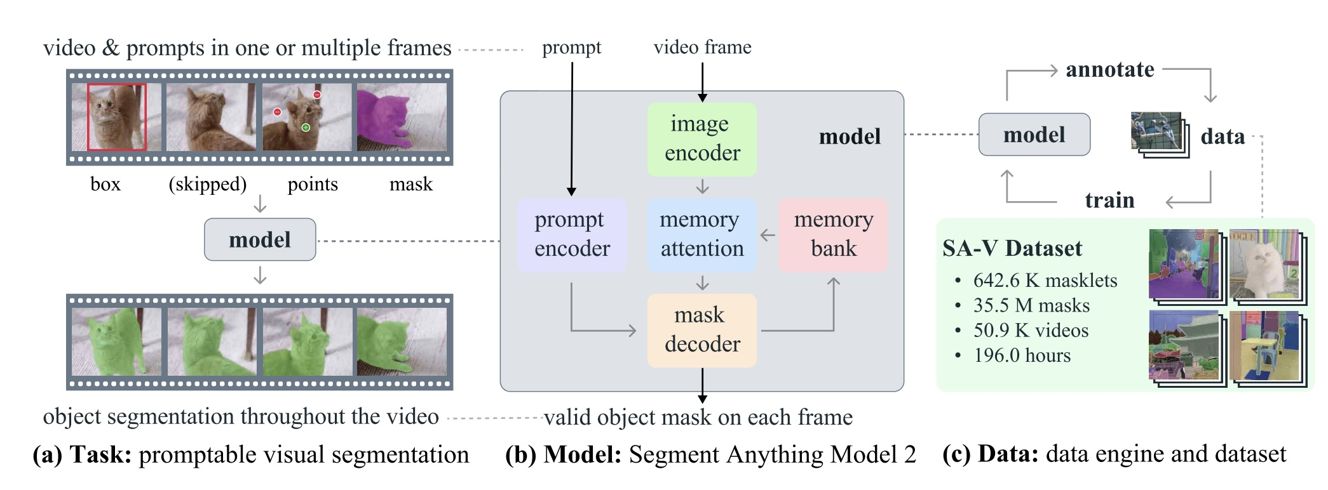
System Architecture

Slide 7
Algorithms
Vision Transformer (ViT)
Extracts deep visual features from each video frame.
Uses self-attention to understand global image context.
Prompt Encoding
Converts user inputs (box, points, mask) into embeddings.
Guides the model on which object to segment.
Self-Attention Mechanism
Learns relationships between image regions.
Improves object understanding within a frame.
Memory Bank
Stores object features and masks from previous frames.
Enables temporal consistency in videos.

Slide 8
Memory Attention (Temporal Attention)
Connects current frame with stored memory.
Maintains object identity across frames.
Mask Decoder
Combines image features, prompts, and memory.
Generates the final segmentation mask.
Mask Propagation
Spreads segmentation across all frames.
Allows tracking with minimal manual input.
Loss Functions (if trained)
Dice Loss and BCE Loss for mask accuracy.
Optimizes segmentation performance.

Slide 9
Components
Image Encoder → Extracts deep visual features from each video frame using a Vision Transformer.
Prompt Encoder → Converts user inputs (clicks, box, mask) into embedding tokens to guide segmentation.
Memory Bank (Video Only) → Stores features and predicted masks from previous frames to maintain object identity.
Memory Attention → Connects current frame features with stored memory for temporal consistency.
Mask Decoder → Uses cross-attention between image features, prompt tokens, and memory to produce:
Pixel-level segmentation mask
IoU confidence score

Slide 10
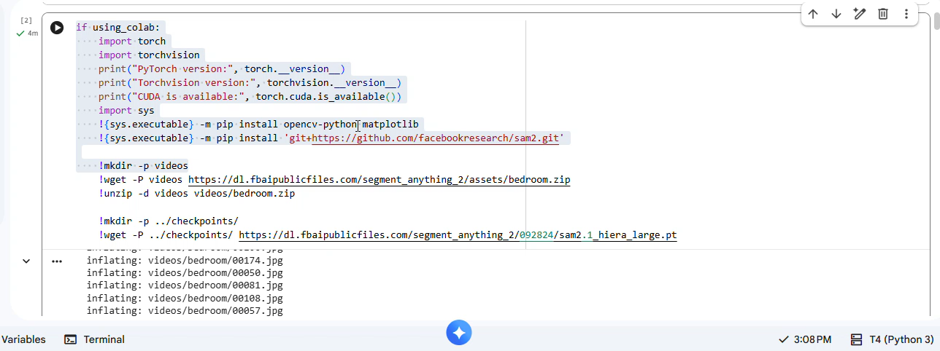
Live Demo of Project

Slide 11

Embedded Video of Project Demo

Slide 12
Evaluation Metrics
Model | Mean IoU | Dice Score | Boundary F-score | Precision | Recall | FPS
Mask R-CNN | 0.76 | 0.81 | 0.74 | 0.83 | 0.79 | 5.2
DeepLabV3+ | 0.79 | 0.84 | 0.77 | 0.85 | 0.82 | 6.1
U-Net | 0.75 | 0.80 | 0.72 | 0.82 | 0.78 | 7.0
SAM-2 (Proposed Model) | 0.89 | 0.92 | 0.86 | 0.93 | 0.90 | 8.5

Slide 13
Key Observations
Higher segmentation accuracy The SAM-2 model achieves higher IoU and Dice scores, indicating better object mask prediction.
Better boundary detection Boundary F-score is significantly higher, meaning the edges of segmented objects are more precise.
Improved multi-object tracking SAM-2 performs better in video segmentation scenarios because it maintains object consistency across frames.
Faster inference Due to the streaming memory architecture, SAM-2 processes frames faster than traditional CNN-based models.

Slide 14
Insights And Recommendations
Insights
The proposed SAM-2 based segmentation model achieved higher segmentation accuracy compared to traditional models like Mask R-CNN and DeepLabV3+.
The system effectively segments multiple objects in video frames with clear boundaries.
The model maintains temporal consistency across frames, improving object tracking in videos.
Recommendations
Optimize the model for higher FPS to enable real-time video applications.
Evaluate the system on larger and diverse datasets to improve robustness.
Extend the model for real-world applications such as surveillance, autonomous systems, and robotics.
Integrate advanced object tracking techniques for better long-term tracking performance.

Slide 15

Conclusion
The project integrates a memory-based mechanism, the system ensures temporal consistency and stable object identity across video frames, reducing common issues such as flickering and identity switching.
The support for interactive prompting enhances flexibility and user control, while the efficient transformer-based architecture enables reliable and near real-time performance.
Overall, the framework provides a scalable, adaptable, and robust solution for dynamic real-world segmentation tasks.

Slide 16

Future Scope
Improve optimization to achieve higher frame rates and enable deployment on edge devices and real-time systems.
Enhance robustness under challenging conditions such as heavy occlusion, fast motion, low-light environments, and complex backgrounds.
Extend the framework to support multimodal inputs (depth, text prompts), 3D segmentation, and adaptive learning for dynamic real-world applications.

Slide 17
References
https://arxiv.org/pdf/2408.00714
https://www.mdpi.com/1424-8220/25/13/4199
https://ai.meta.com/datasets/segment-anything-video/
https://huggingface.co/papers/2411.17646

Slide 18

Notes:
thank you very much for joining this PPT, keep learning.
18

